Slide 1

CSE- 321
Software Engineering
Lecture : 14 Software design
Fahad Ahmed
Lecturer, Dept. of CSE
E-mail: fahadahmed@uap-bd.edu

Slide 2
Lecture Outlines
Architectural Design
Distributed Systems Architectures
Client-Server Architecture
Broker Architectural Style : CORBA
Service-Oriented Architecture (SOA)

Slide 3
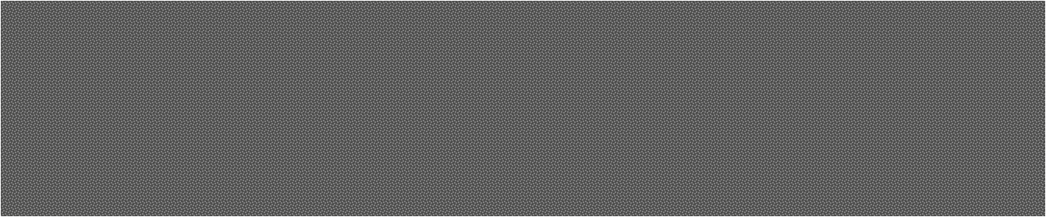

Architectural Design

Slide 4
Architectural Design
Architectural design is a process for identifying the sub-systems making up a system and the framework for sub-system control and communication.
The output of this design process is a description of the software architecture.
It represents the link between specification and design processes
Often carried out in parallel with some specification activities.
It involves identifying major system components and their communications.

Slide 5
Architectural Design
A software architecture is a description of how a software system is organized.
Architectural design decisions include decisions on the type of application, the distribution of the system, the architectural styles to be used.
Architectures may be documented from several different perspectives or views such as a conceptual view, a logical view, a process view, and a development view.
Architectural patterns are a means of reusing knowledge about generic system architectures.
Architectural patterns are similar to software design pattern but have a broader scope.

Slide 6
Architectural design decisions
Architectural design is a creative process so the process differs depending on the type of system being developed.
However, a number of common decisions span all design processes.
Is there a generic application architecture that can be used?
How will the system be distributed?
What architectural styles are appropriate?
What approach will be used to structure the system?
How will the system be decomposed into modules?
What control strategy should be used?
How will the architectural design be evaluated?
How should the architecture be documented?

Slide 7
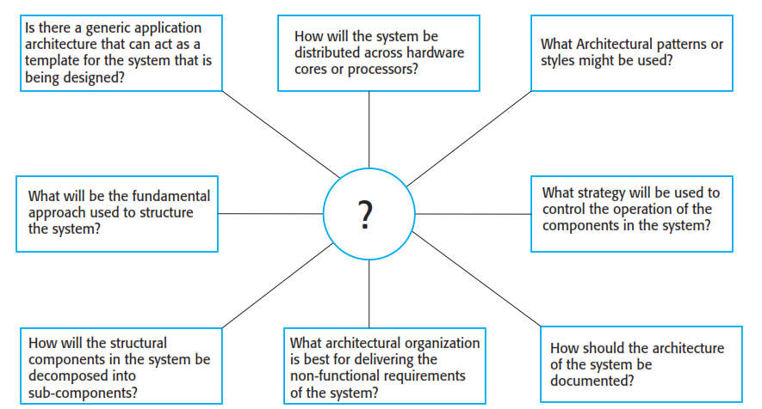
Architectural design decisions

Slide 8
Architectural views
4 + 1 view model of software architecture
· A logical view, which shows the key abstractions in the system as objects or object classes.
· A process view, which shows how, at run-time, the system is composed of interacting processes.
· A development view, which shows how the software is decomposed for development.
· A physical view, which shows the system hardware and how software components are distributed across the processors in the system.
· Related using use cases or scenarios (+1)

Slide 9
Architectural patterns
Patterns are a means of representing, sharing and reusing knowledge.
An architectural pattern is a stylized description of good design practice, which has been tried and tested in different environments.
Patterns should include information about when they are and when they are not useful.
Patterns may be represented using tabular and graphical descriptions.

Slide 10
The Model-View-Controller (MVC) pattern
MVC was called “Thing Model View Editor”
Serves as a basis of interaction management in many web-based systems.
Decouples three major interconnected components:
The model is the central component of the pattern that directly manages the data, logic and rules of the application. It is the application's dynamic data structure, independent of the user interface.
A view can be any output representation of information, such as a chart or a diagram. Multiple views of the same information are possible.
The controller accepts input and converts it to commands for the model or view.
Supported by most language frameworks.

Slide 11
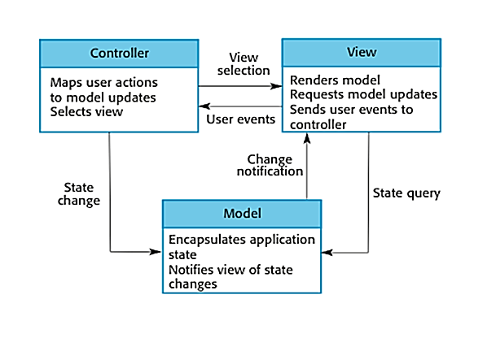
The Model-View-Controller (MVC) pattern

Slide 12
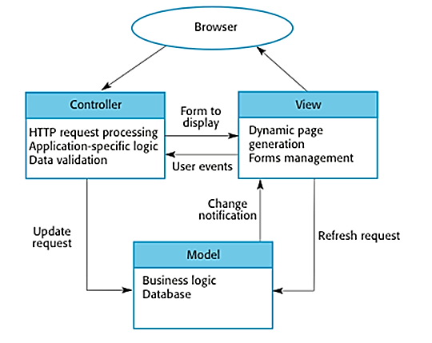
The Model-View-Controller (MVC) pattern
Web application architecture using the MVC pattern

Slide 13
The Model-View-Controller (MVC) pattern
Case- Study : restaurant
Let's assume you go to a restaurant. You will not go to the kitchen and prepare food which you can surely do at your home. Instead, you just go there and wait for the waiter to come on.
Now the waiter comes to you, and you just order the food. The waiter doesn't know who you are and what you want he just written down the detail of your food order.
Then, the waiter moves to the kitchen. In the kitchen waiter not prepare your food.
The cook prepares your food. The waiter is given your order to him along with your table number.
Cook then prepared food for you. He uses ingredients to cooks the food. Let's assume that your order a vegetable sandwich. Then he needs bread, tomato, potato, capsicum, onion, bit, cheese, etc. which he sources from the refrigerator
Cook final hand over the food to the waiter. Now it is the job of the waiter to moves this food outside the kitchen.
Now waiter knows which food you have ordered and how they are served.

Slide 14
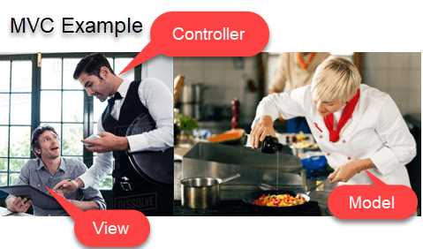
The Model-View-Controller (MVC) pattern
Case- Study : restaurant
In this case,
You= View
Waiter= Controller
Cook= Model
Refrigerator= Data

Slide 15
Layered architecture
Used to model the interfacing of sub-systems.
Organizes the system into a set of layers (or abstract machines) each of which provide a set of services.
Supports the incremental development of sub-systems in different layers. When a layer interface changes, only the adjacent layer is affected.
However, often artificial to structure systems in this way.

Slide 16
Layered architecture
When used
Used when building new facilities on top of existing systems; when the development is spread across several teams with each team responsibility for a layer of functionality; when there is a requirement for multi-level security.
**Allows replacement of entire layers so long as the interface is maintained.

Slide 17
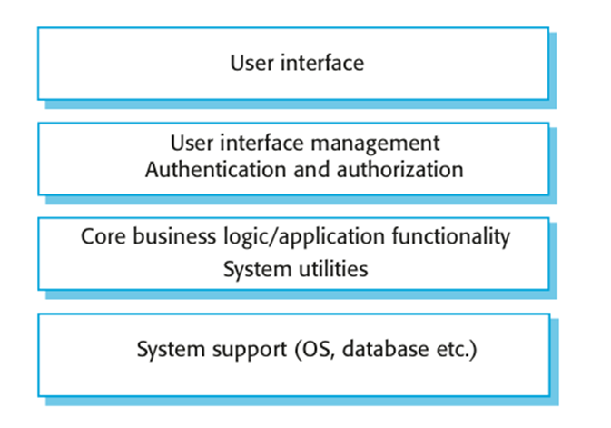
A generic layered architecture

Slide 18
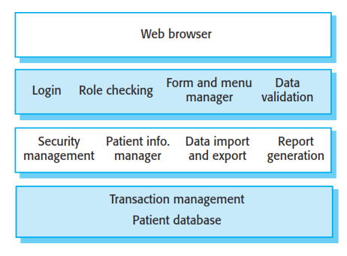
The architecture of the Mentcare system
This system maintains and manages details of patients who are consulting specialist doctors about mental health problems.

Slide 19
The architecture of the Mentcare system
The top layer is a browser-based user interface.
2. The second layer provides the user interface functionality that is delivered through the web browser. It includes components to allow users to log-in to the system and checking components that ensure that the operations they use are allowed by their role. This layer includes form and menu management components that present information to users, and data validation components that check information consistency.
3. The third layer implements the functionality of the system and provides components that implement system security, patient information creation and updating, import and export of patient data from other databases, and report generators that create management reports.
4. Finally, the lowest layer, which is built using a commercial database management system, provides transaction management and persistent data storage.

Slide 20
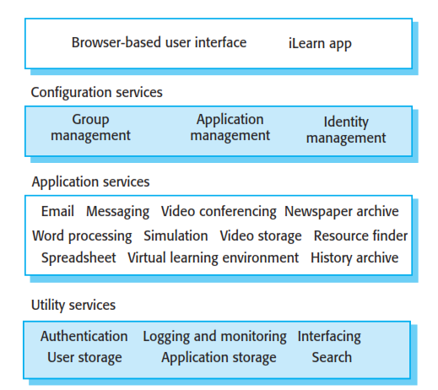
The architecture of the iLearn system

Slide 21
The repository model
Sub-systems must exchange data. This may be done in two ways:
Shared data is held in a central database or repository and may be accessed by all sub-systems;
Each sub-system maintains its own database and passes data explicitly to other sub-systems.
When large amounts of data are to be shared, the repository model of sharing is most commonly used.

Slide 22
The repository model
Advantages
Efficient way to share large amounts of data;
Sub-systems need not be concerned with how data is produced
Centralised management e.g. backup, security, etc.
Sharing model is published as the repository schema.
Disadvantages
Sub-systems must agree on a repository data model. Inevitably a compromise;
Data evolution is difficult and expensive;
No scope for specific management policies;
Difficult to distribute efficiently.

Slide 23
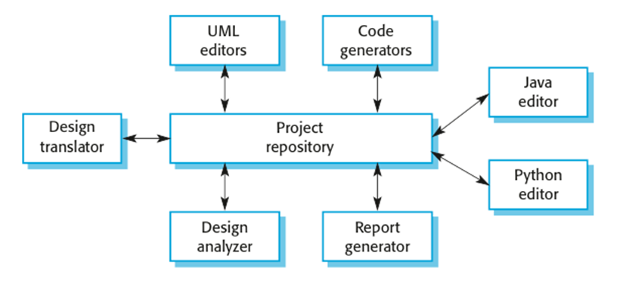
A repository architecture for an IDE

Slide 24
A repository architecture
Given reasons for your answer, suggest an appropriate structural model for the following systems:
A robot floor-cleaner that is intended to clean relatively clear spaces such as corridors. The cleaner must be able to sense walls and other obstructions.

Slide 25
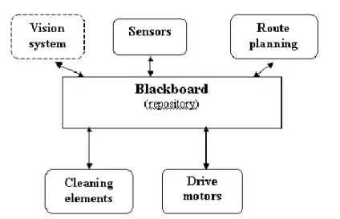
A repository architecture
A robot floor-cleaner that is intended to clean relatively clear spaces such as corridors. The cleaner must be able to sense walls and other obstructions.

Slide 26
A repository architecture
A robot floor-cleaner that is intended to clean relatively clear spaces such as corridors. The cleaner must be able to sense walls and other obstructions.
The most appropriate model is a repository model, with each of the subsystems (wall and obstacle sensors, path planning, vision (perhaps), etc.) placing information in the repository for other subsystems to use.
Robotic applications are in the realm of Artificial intelligence, and for the AI systems such as this, a special kind of repository called a blackboard (where the presence of data activates particular subsystems) is normally used

Slide 27
Control styles
Are concerned with the control flow between sub-systems. Distinct from the system decomposition model.
Centralised control
One sub-system has overall responsibility for control and starts and stops other sub-systems.
Event-based control
Each sub-system can respond to externally generated events from other sub-systems or the system’s environment.

Slide 28
Centralised control
A control sub-system takes responsibility for managing the execution of other sub-systems.
Call-return model
Top-down subroutine model where control starts at the top of a subroutine hierarchy and moves downwards. Applicable to sequential systems.
Manager model
Applicable to concurrent systems. One system component controls the stopping, starting and coordination of other system processes. Can be implemented in sequential systems as a case statement.

Slide 29
Call-return model
Centralised control

Slide 30
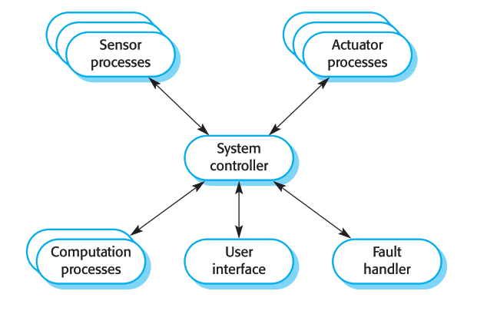
A centralized control model for a real-time system
Centralised control

Slide 31

Thanks to All

